Slide 1
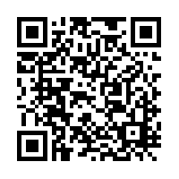
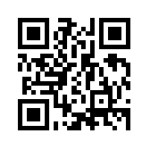


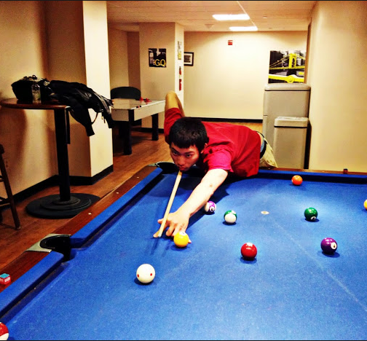

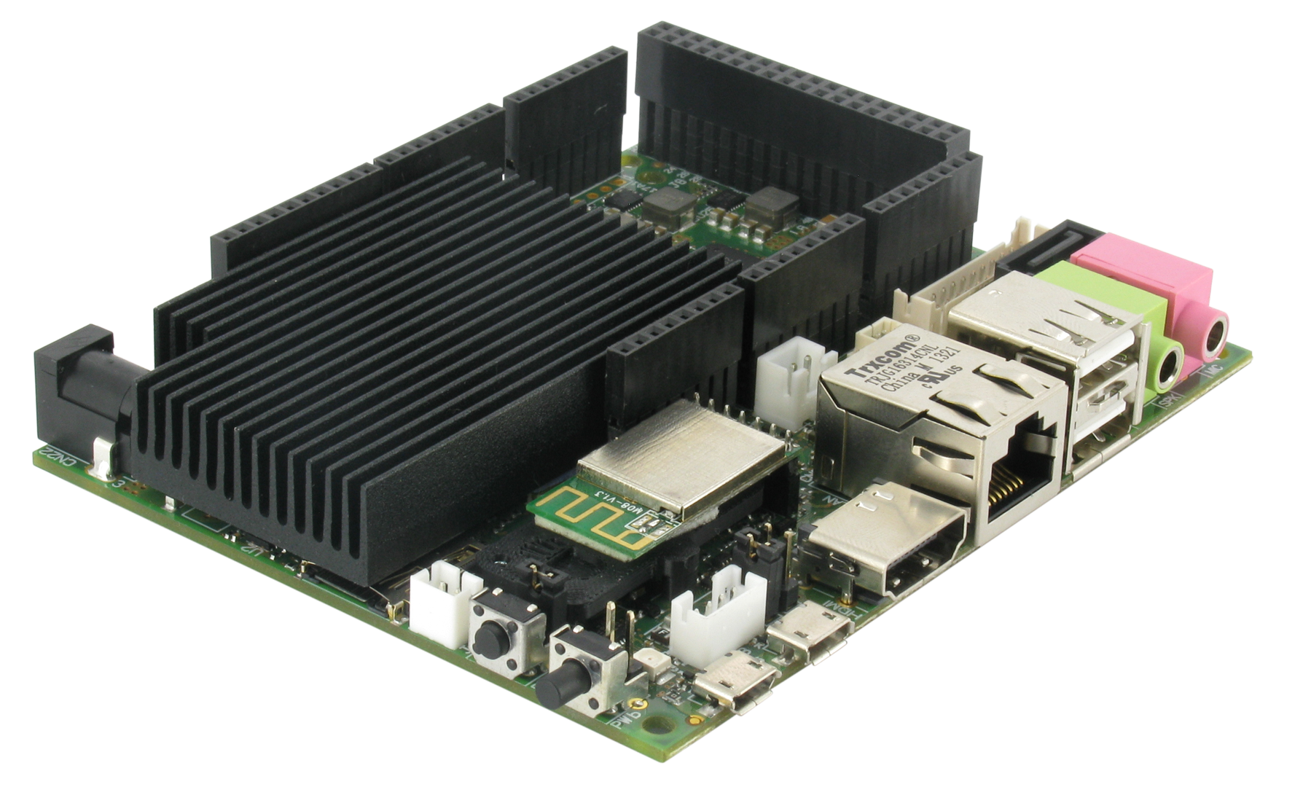
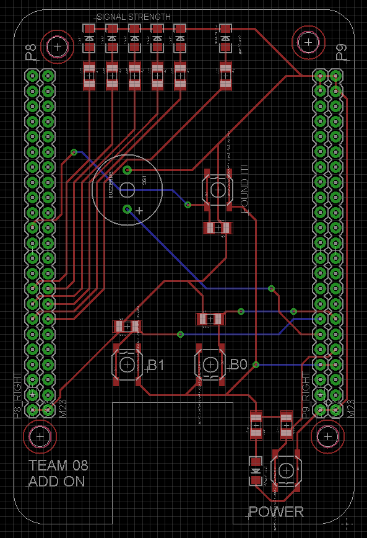
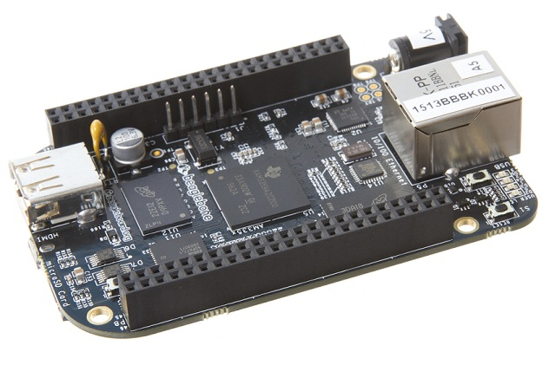
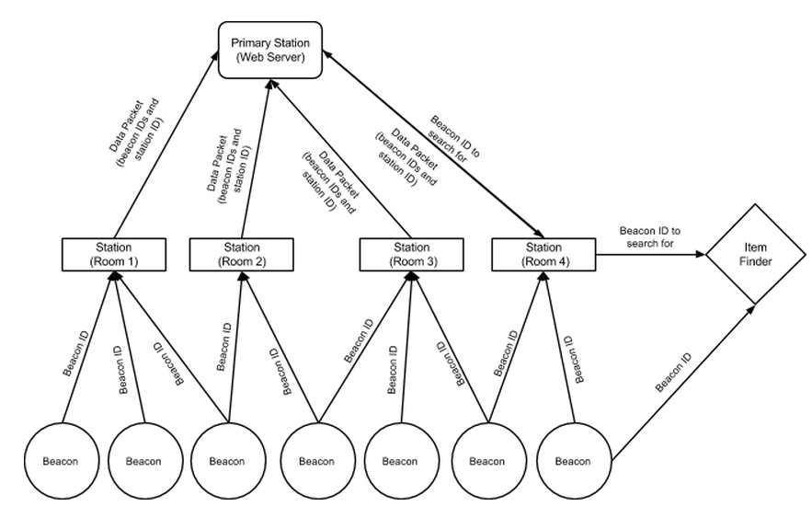
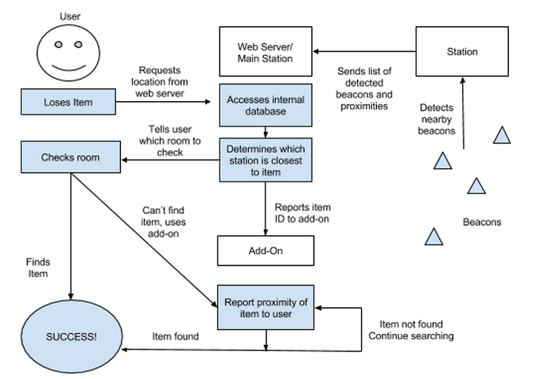


Placeholder
Electrical and Computer Engineering Department
Carnegie Mellon University
Arman Bolat, Bryan Tan, Michael Chen, Nathaniel Jansen
{abolat,bstan,mechen,njansen}@ece.cmu.edu
Our Website
Try it yourself!
(CMU Network only)
Introduction
Design Goals
Never find yourself digging through your cabinets to find your passport, or going through all your coats to locate your car keys with Placeholder.
With Bluetooth LE beacons, stations that keep track of the beacons, and an item-finding add-on, Placeholder helps you keep track of where you put your stuff.
1) Allow easy location of any item with a BLE tag attached
2) Simple set up – Just plug in, press a button, and go!
3) Add-on Item finder allows for finer grain searching through proximity detection
4) Intuitive web design to make to make user experience easy and pleasant
Hardware
Stations
Add-On Item Finder
Arman Bolat
Bryan Tan
Michael Chen
Nathaniel Jansen
Signal Strength
Concept
Buzzer
Status
LED
Placeholder is a full home system that eliminates the need to ever search endlessly for your stuff again. By placing stations in every room that communicate with a central web server and Bluetooth Low Energy beacons attached to your items, most items can be found in a matter of seconds.
If you need more help finding your item, have the web server send the unique item ID to the add-on item finder that will display your proximity to it on 5 LEDs. When you’re really close, it will even buzz!
“Found it!” Button
UDOO: Station + Server
Power LED/Button
Designed to fit on BeagleBone Black
BeagleBone Black:
Station
Architecture Diagram and User Interaction Flow Chart
18-549 Embedded Design Capstone S’15

